Slide 1


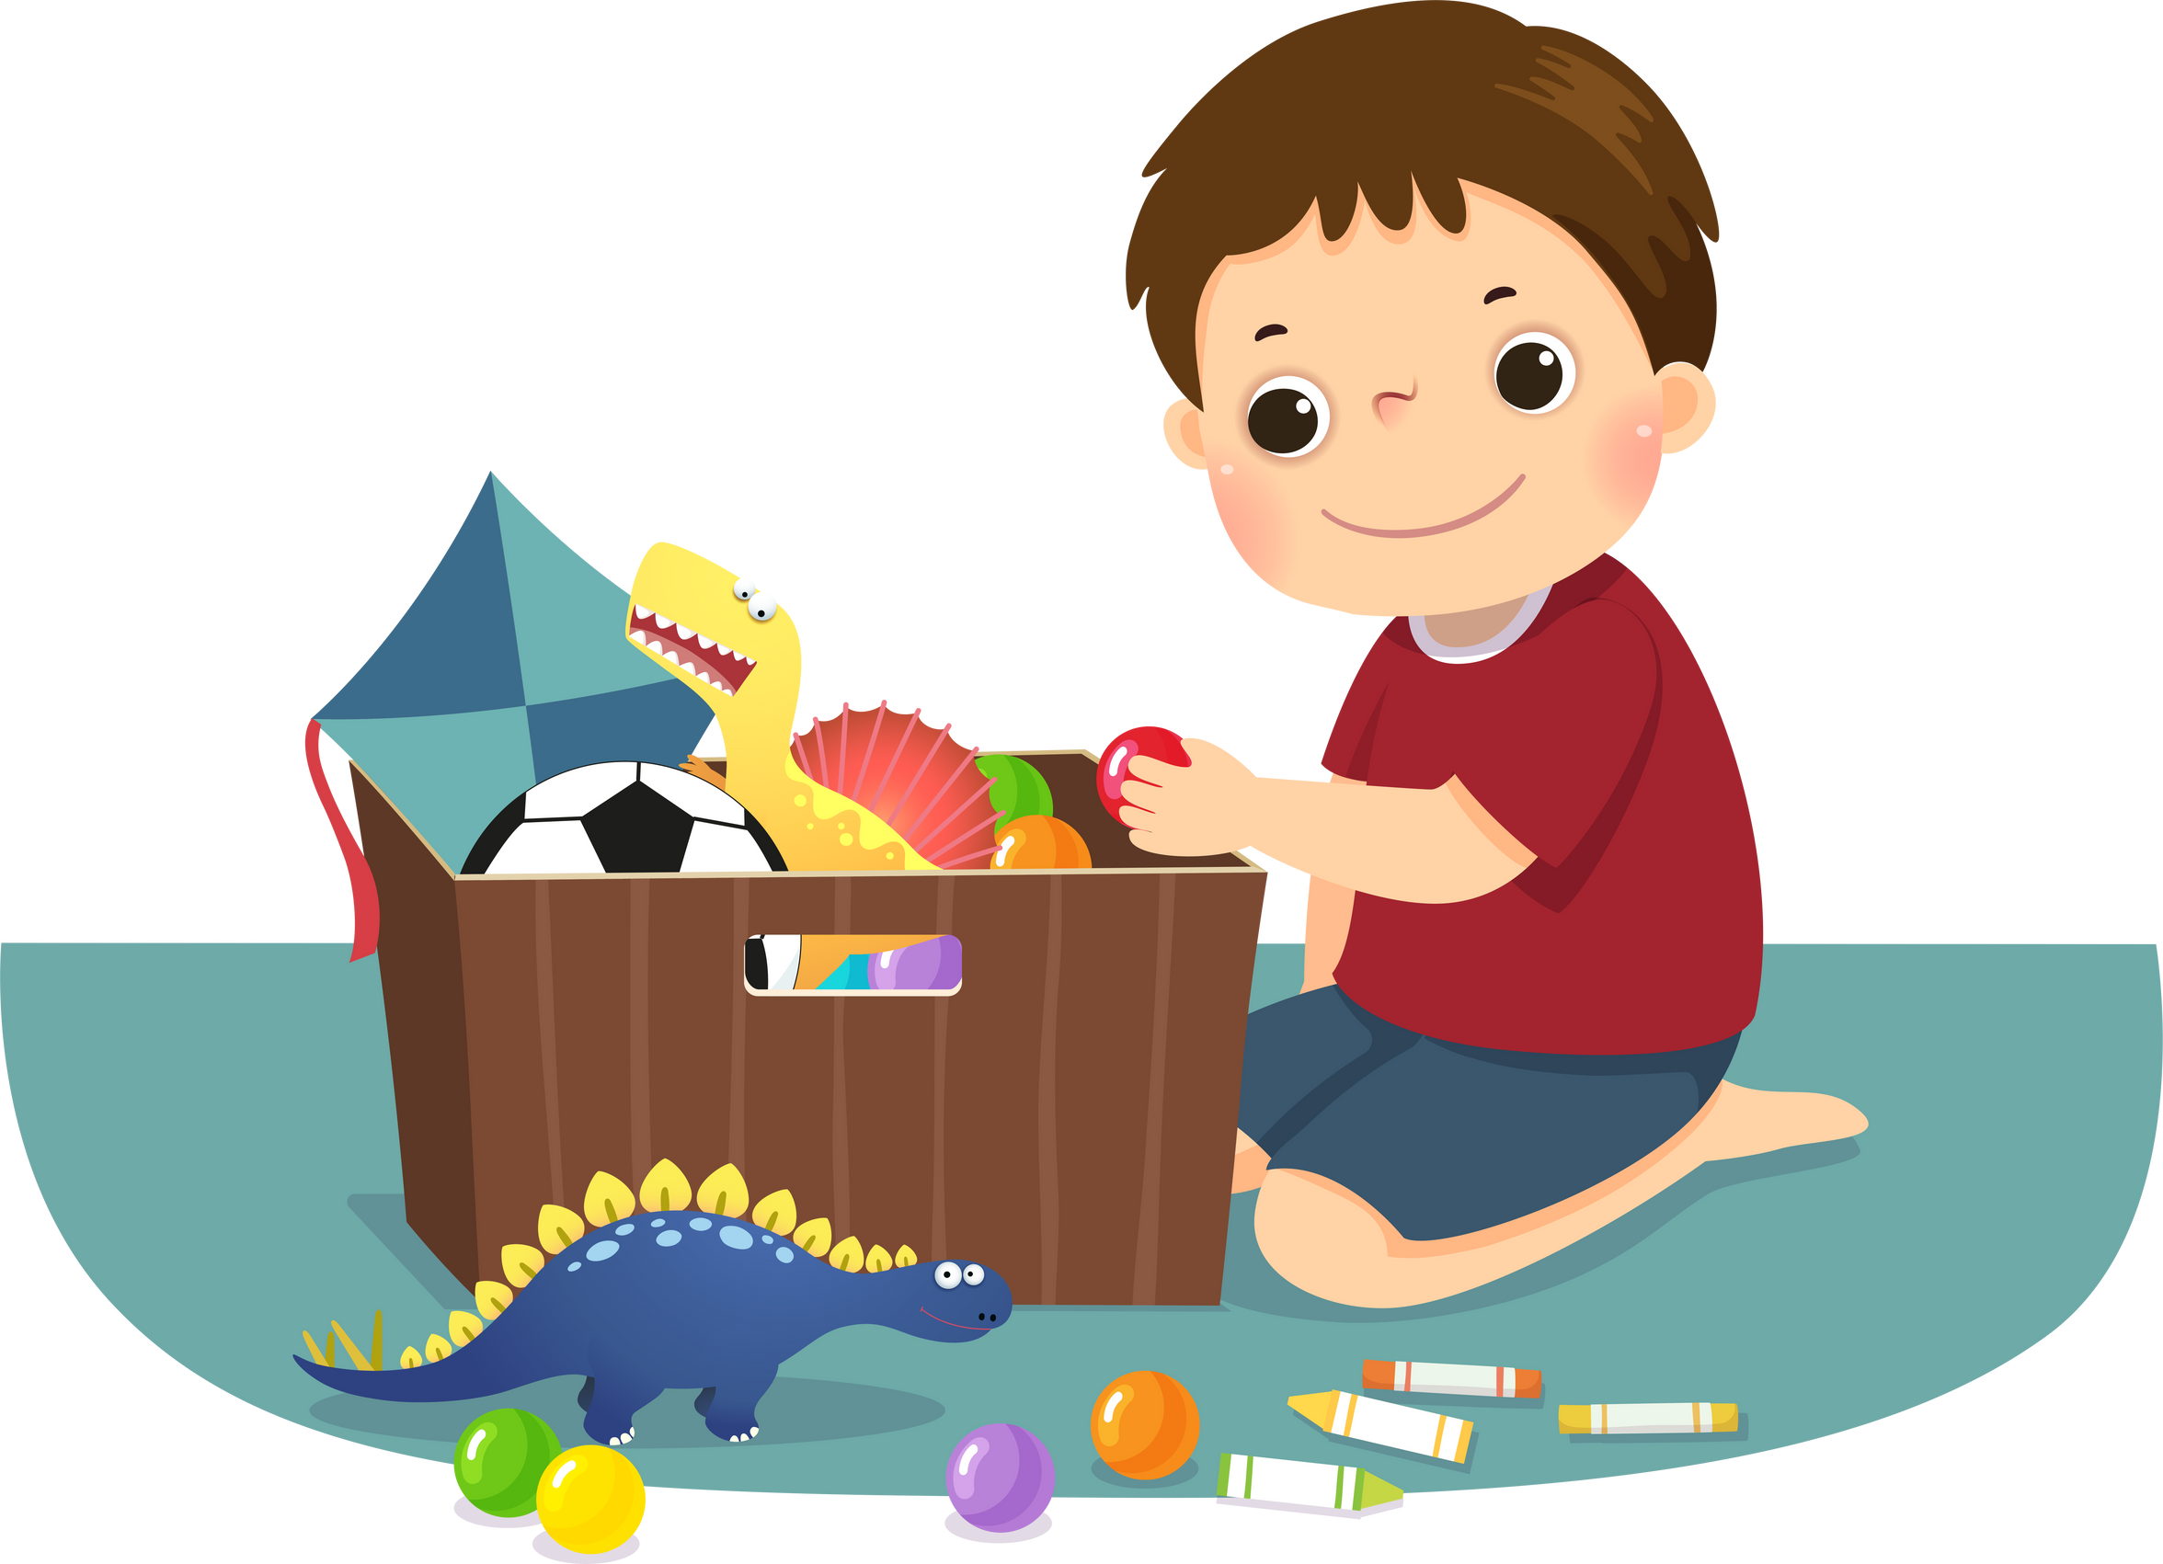

1/2M Classroom Behaviour Matrix
 | We are learners By doing our work like maths, writing, reading By being with our class By trying our best By showing whole body listening
 | We are respectful By putting our hand up By being nice and saying compliments By listening and not talking when others are talking By being helpful
 | We are responsible By being in the correct area. By cleaning up our area By taking home our lunch box and drink bottle
 | We are safe By leaving chairs and tables in their place By keeping our hands, feet and objects to ourselves By walking around the classroom By having 4 chair legs on the floor all the time By staying the right area

